Slide 1
How does darkness affect pedestrian and cyclist counts in Bristol?
Assessing whether darkness discourages nighttime activity
Group members: Shavarsh, Karan, Will, Tom, Jayden

Slide 2
Why study darkness in Bristol?
Carbon neutral by 2030 + 55% active travel [3]
£12m
LED upgrade
2023 - 2025 [1]
7% walking increase
22% cycling increase
Across East Bristol (2025) [2]
[1] Bristol LED street lighting: bristol.gov.uk
[2] East Bristol Liveable Neighbourhood monitoring report
[3] Bristol climate targets: bristol.gov.uk

Slide 3
What are our objectives?
Gather local data
Compare case-control OR and time-series GLM
Inform lighting & active-travel decisions
[4] Fotios et al. (2024), odds-ratio sensitivity

Slide 4
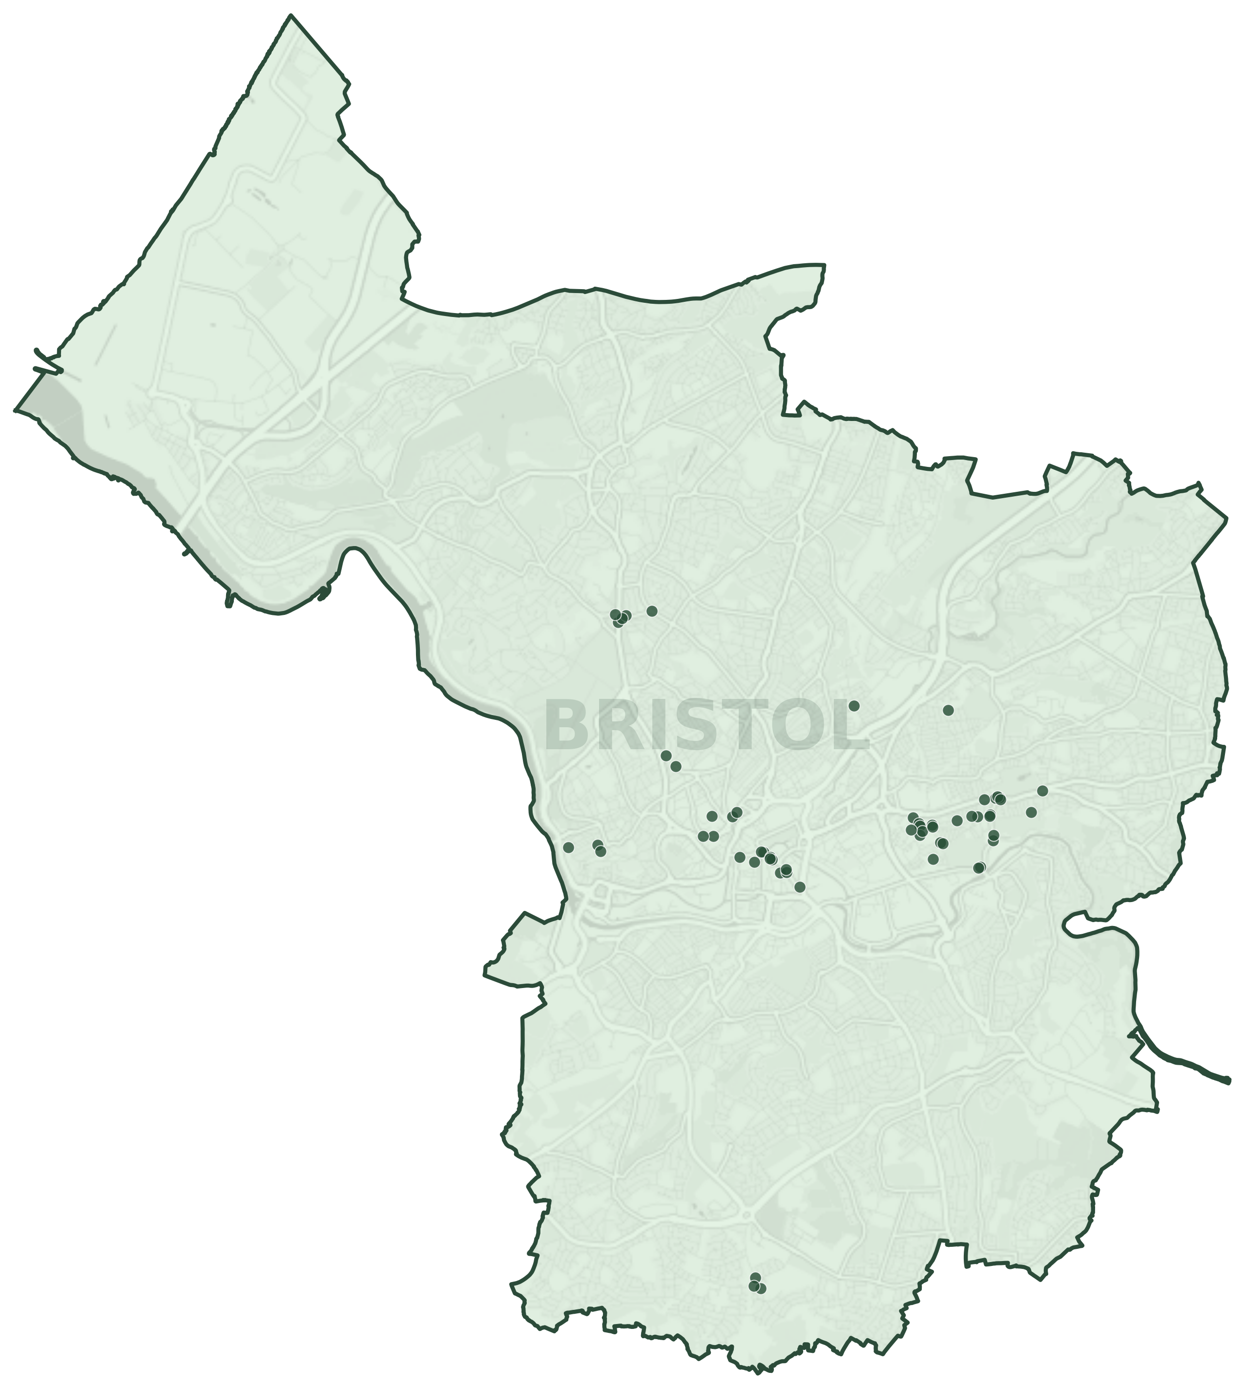
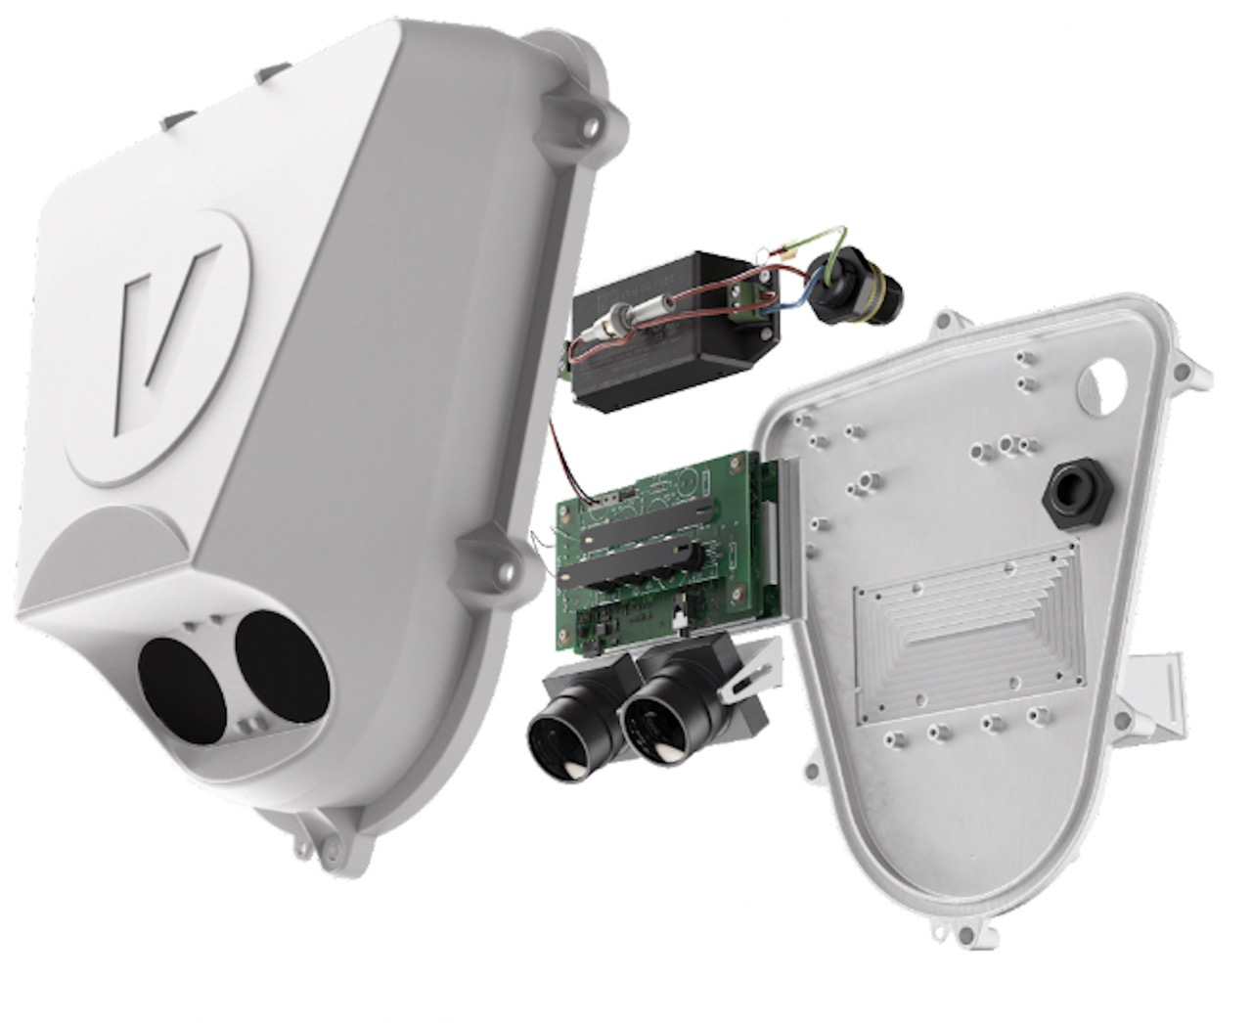
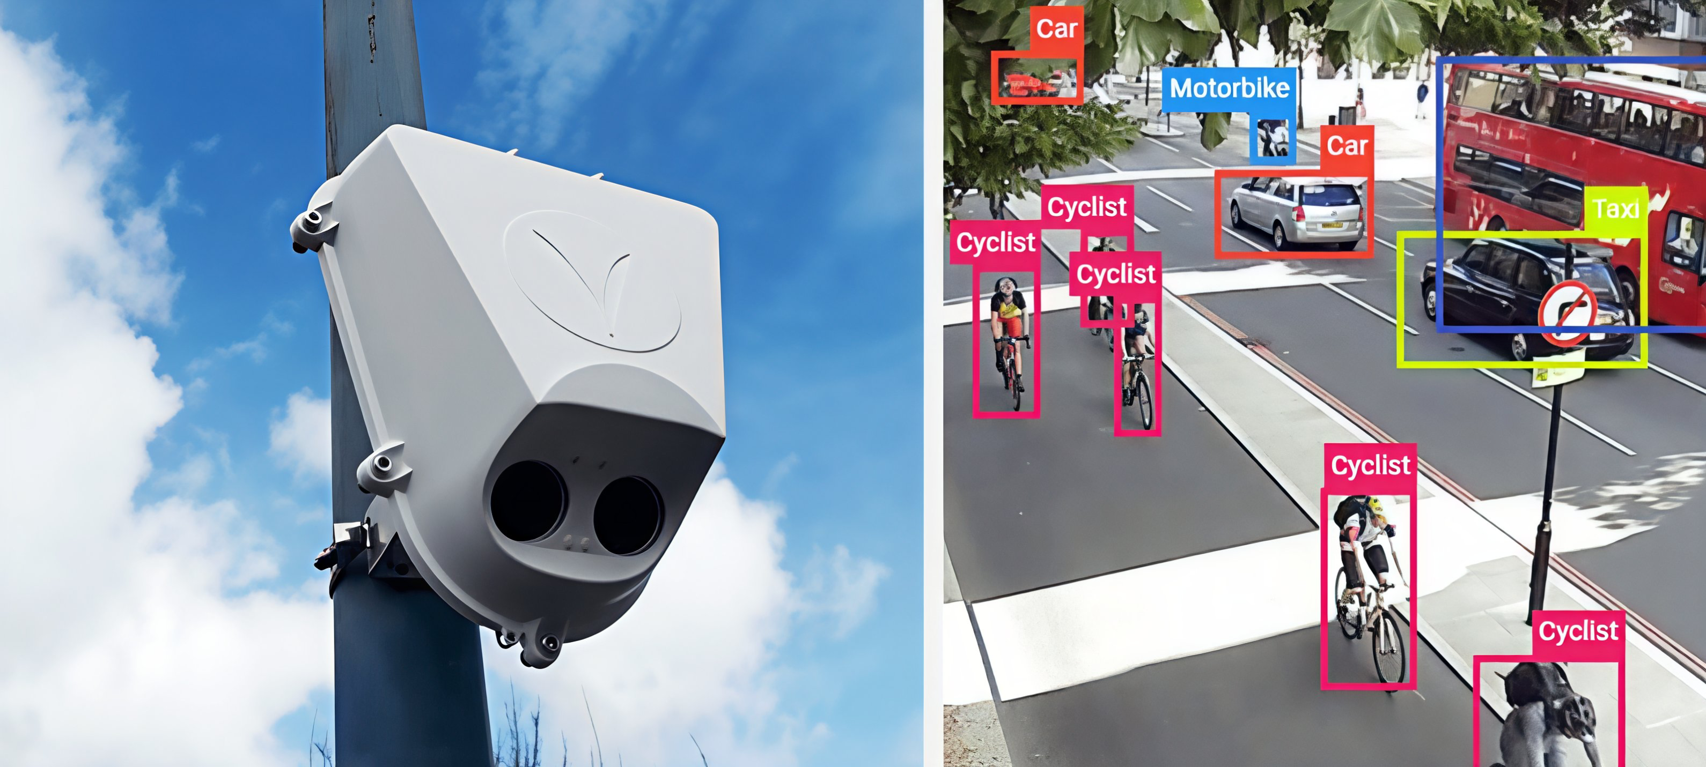
Our Data Source
1
What?
2
How?
3
Where?
Vivacity’s camera sensors [5]
AI classification
58 deployed across Bristol [6]
[5] Vivacity Labs, Sensor Platform Technical Brochure
[6] Tong & Bode, Hourly Traffic Counts… Bristol, UK (Zenodo).

Slide 5
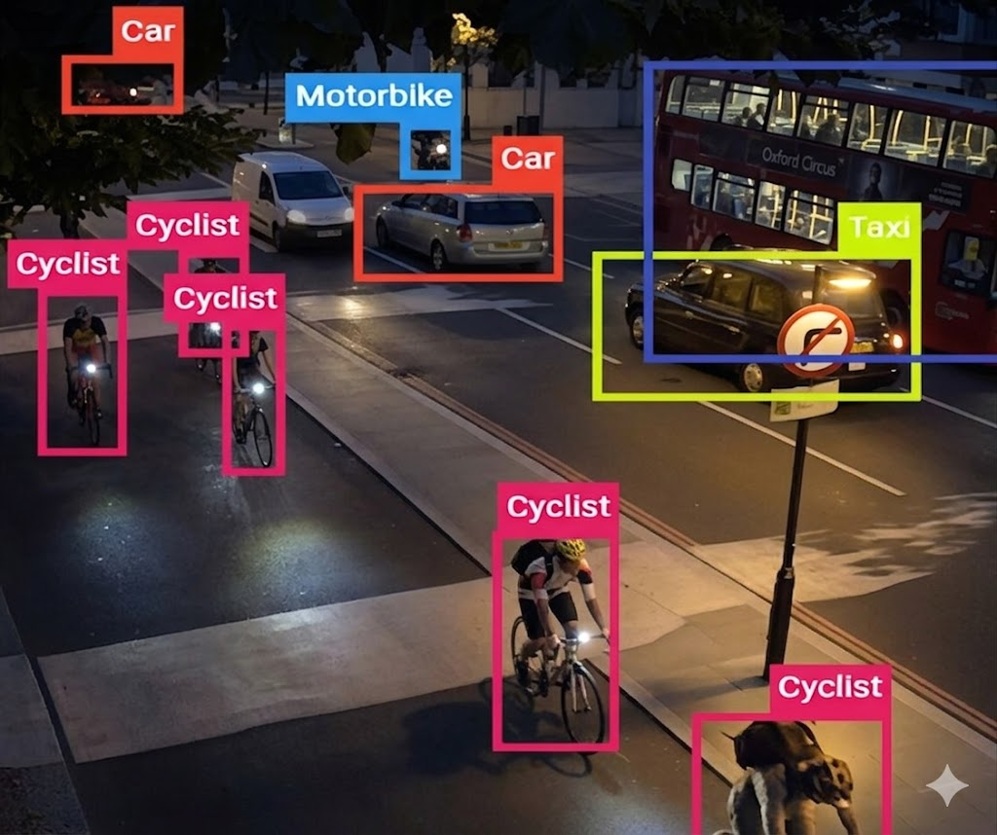
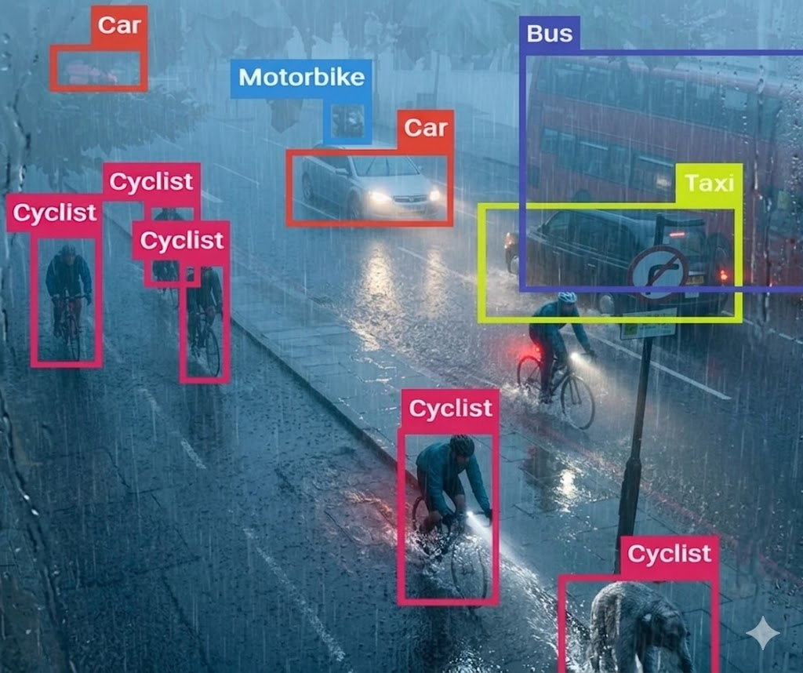
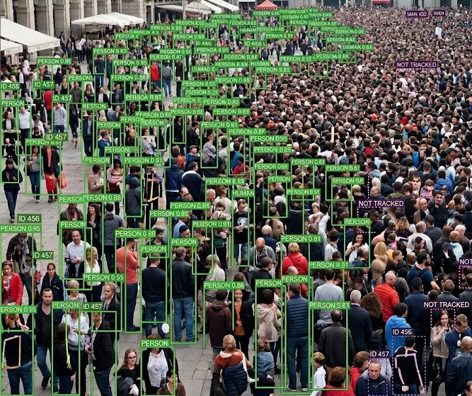
Limitations of the Data
Accuracy of the sensor counts are not 100% accurate[7]
1
Darkness
2
Rain/Fog
3
Crowd Density
[7] Cambridgeshire County Council Research Group. (2022). Vivacity Sensor Performance Monitoring: June 2022 data.

Slide 6
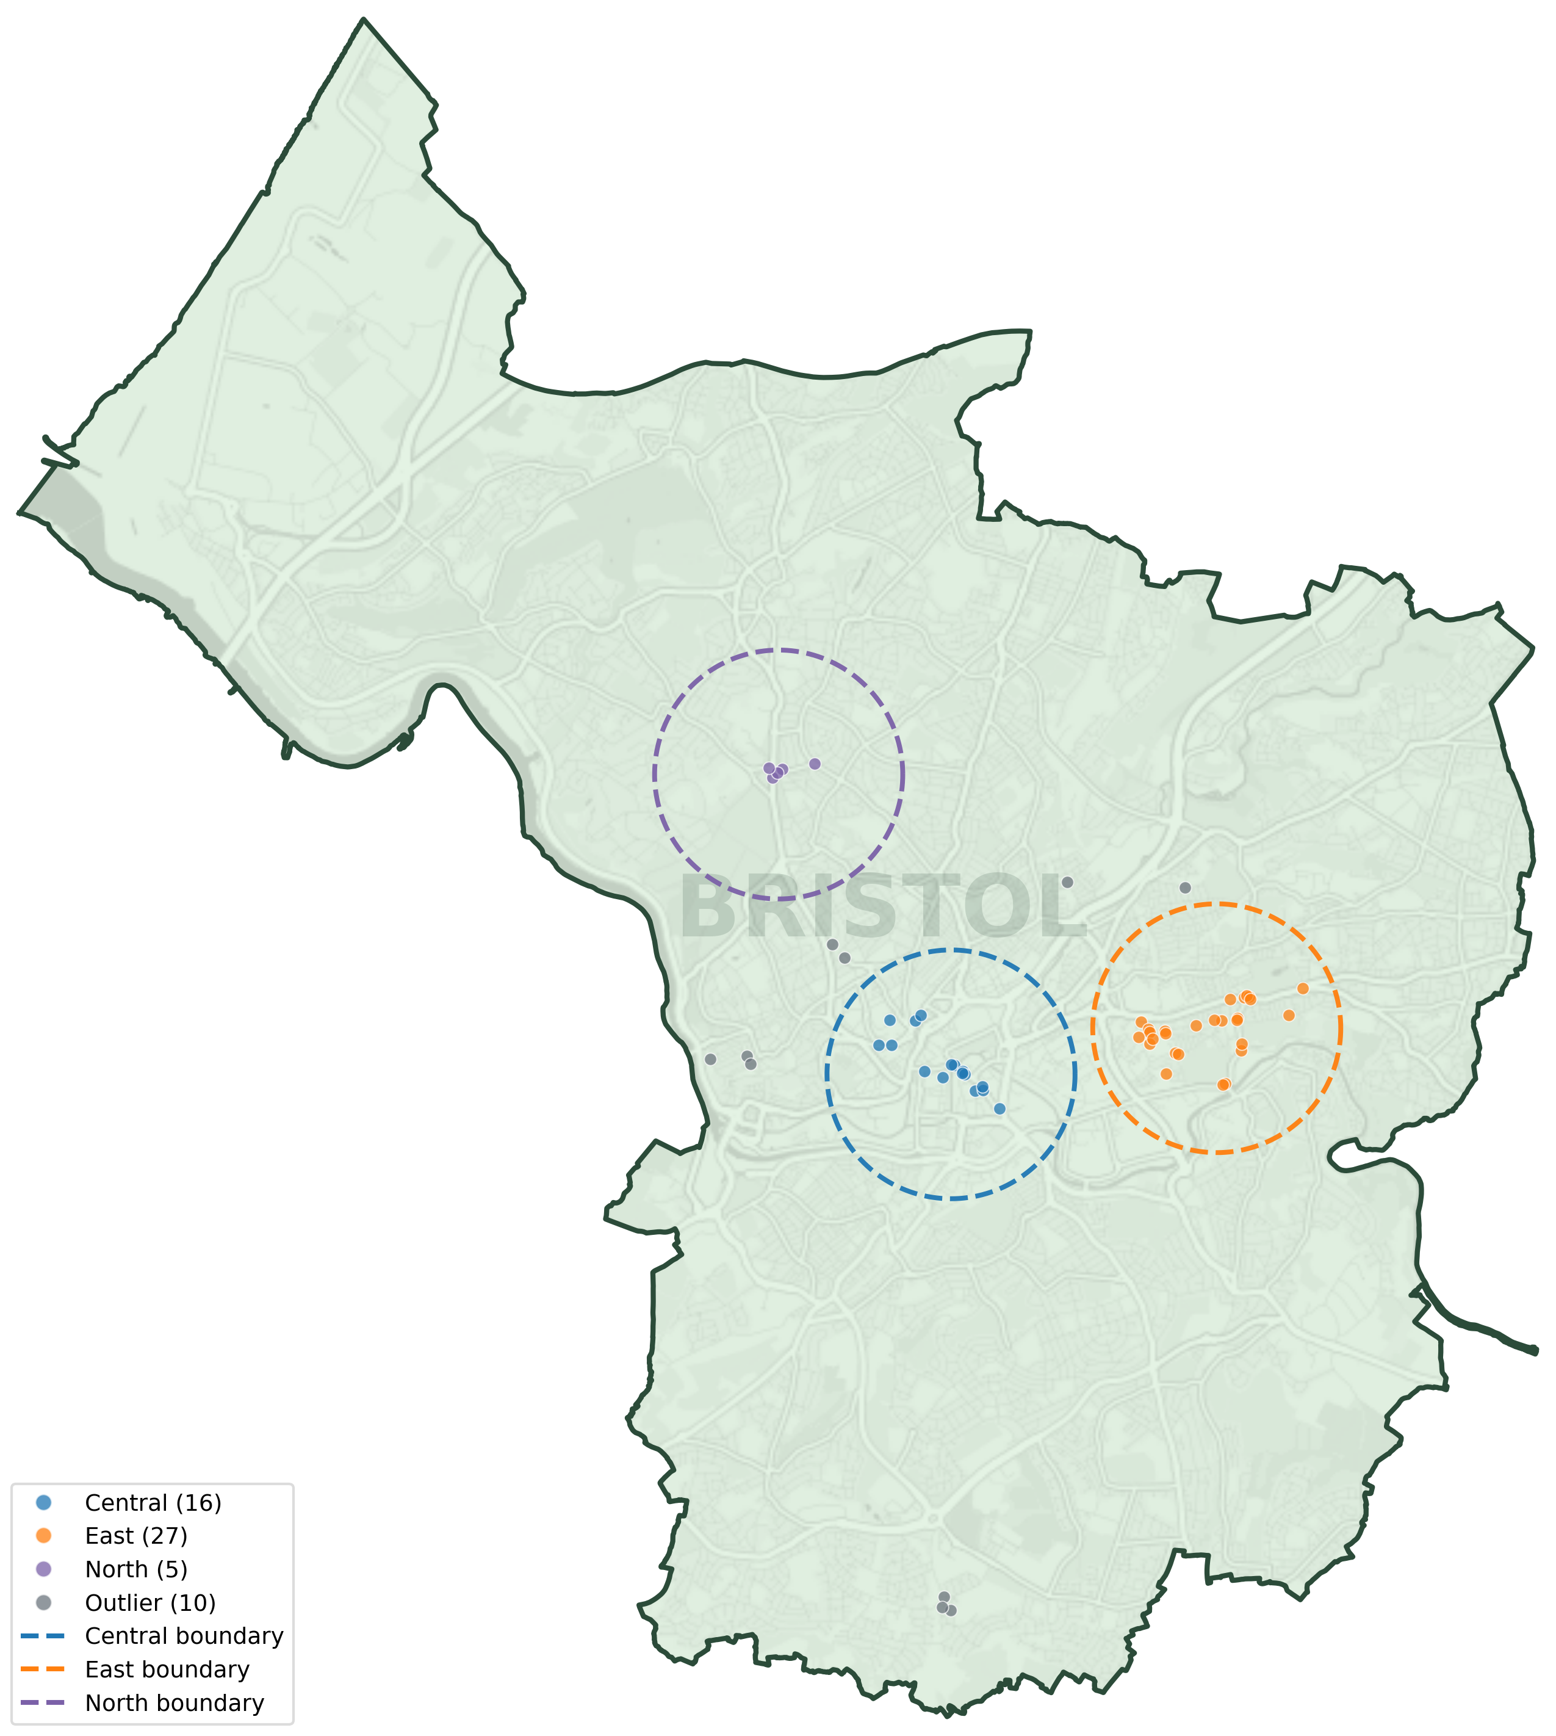
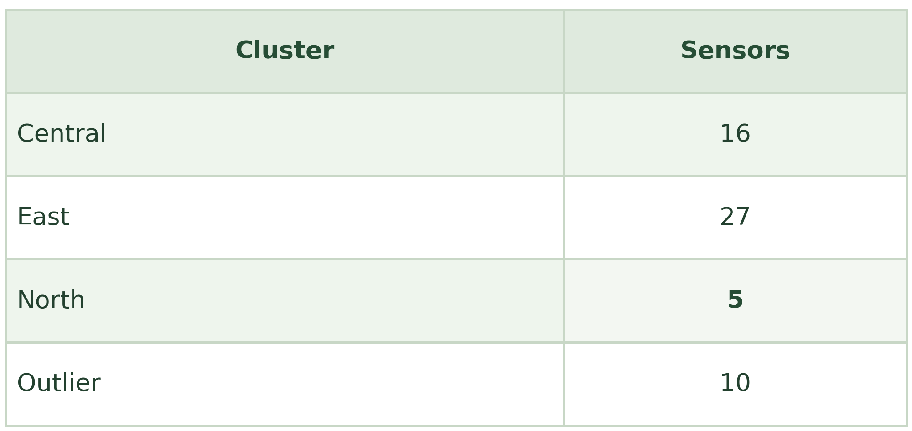
Data Processing
Grouping Sensors by Location
See Technical note PDF for detail on how we did this.

Slide 7
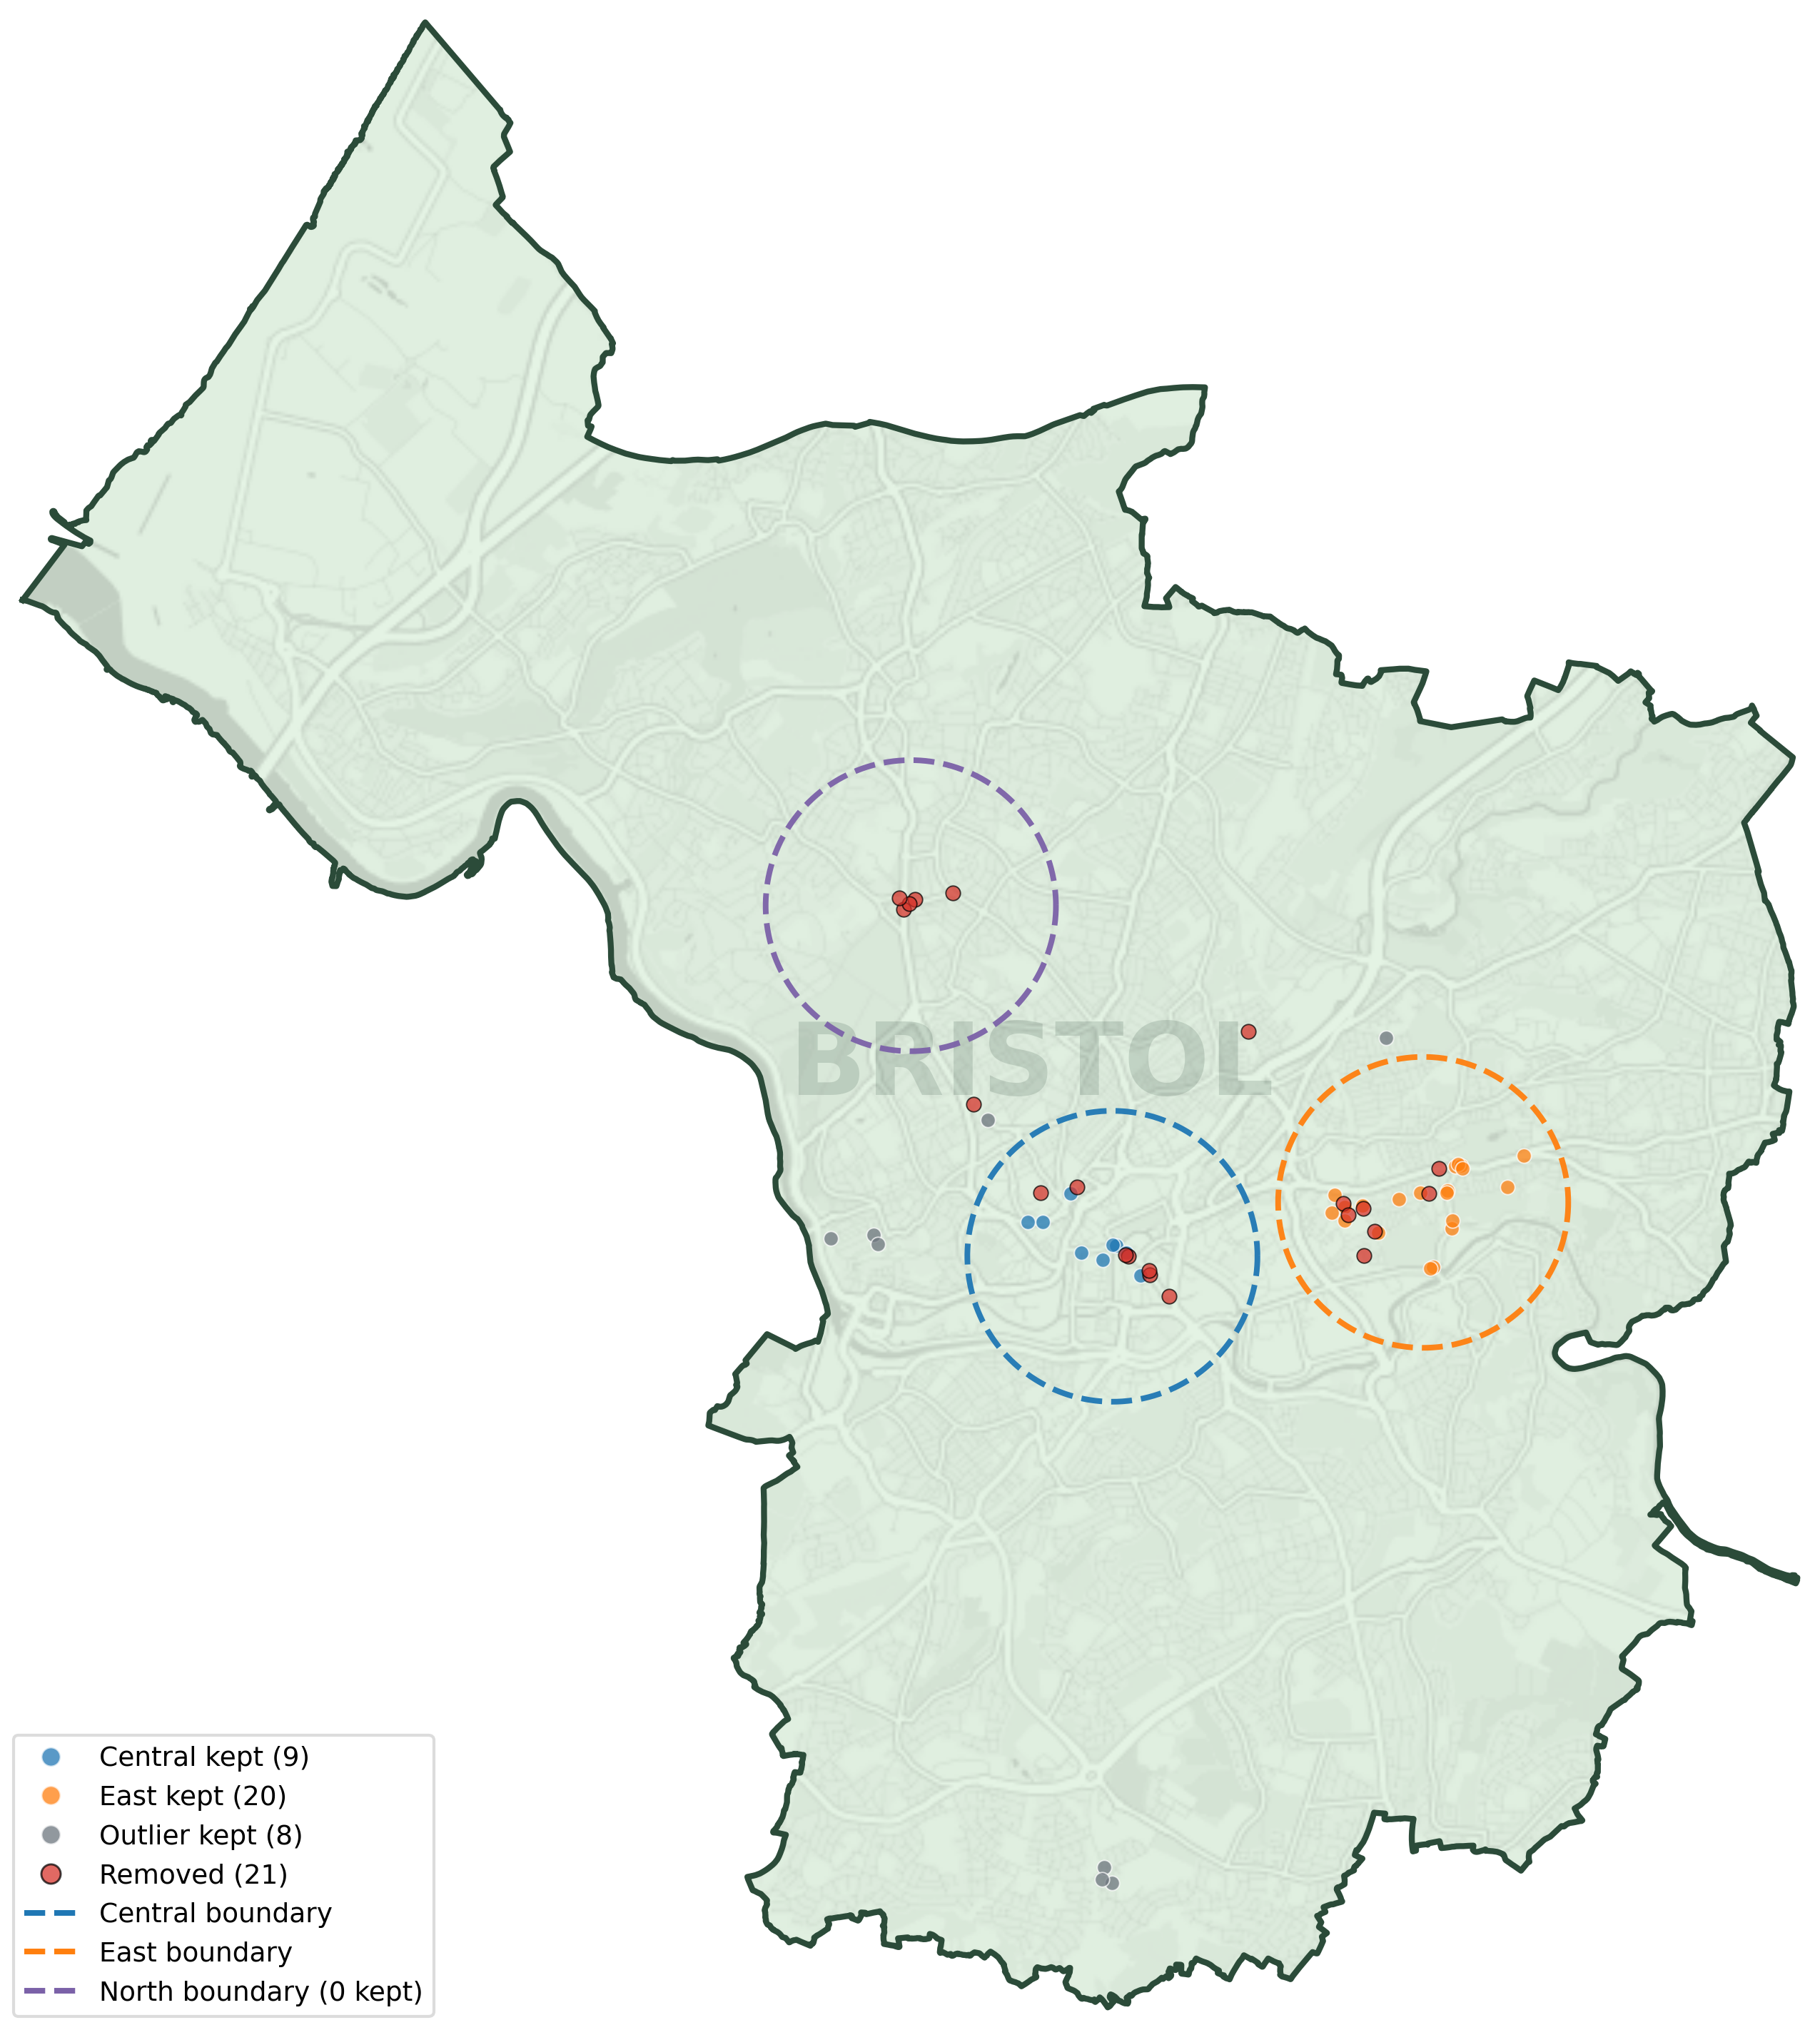
Data Processing
Addressing Missing Values
Removed sensors with 7+ consecutive zero-count days across pedestrians, and cyclists.
Reduced bias
Increased accuracy

Slide 8
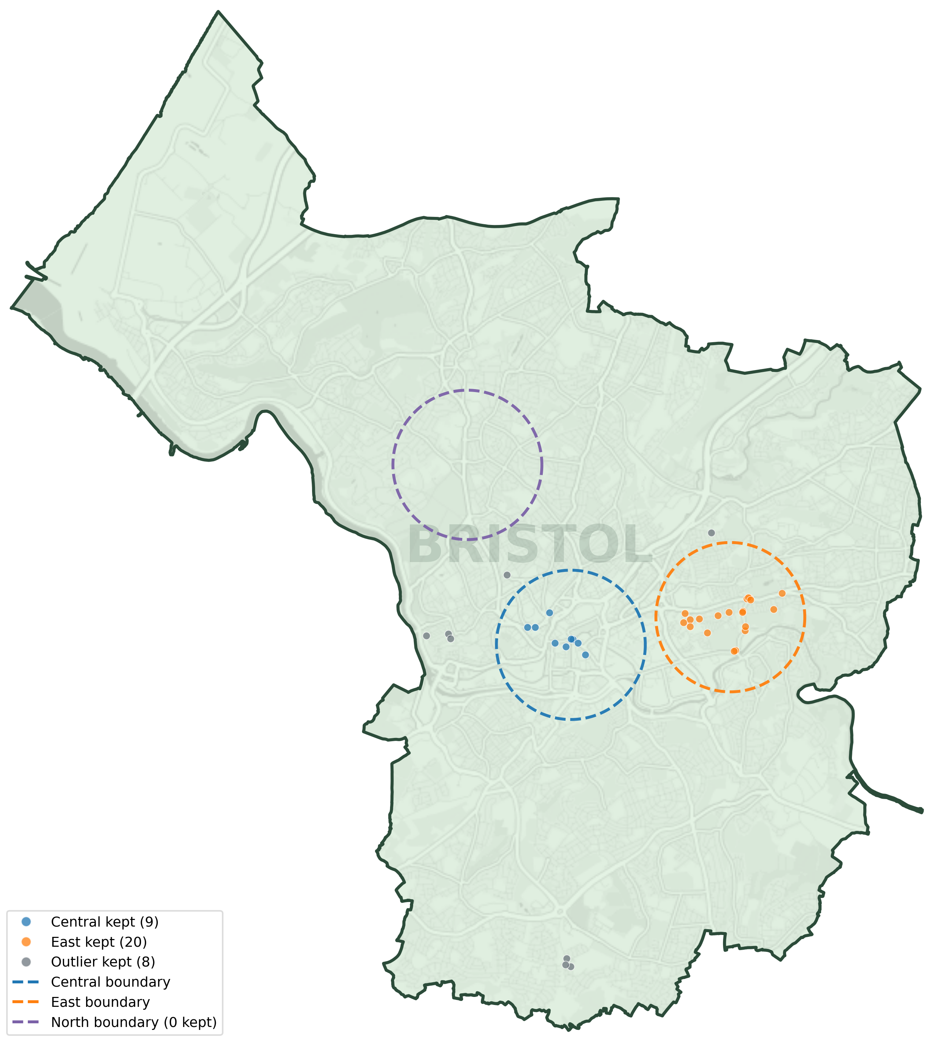
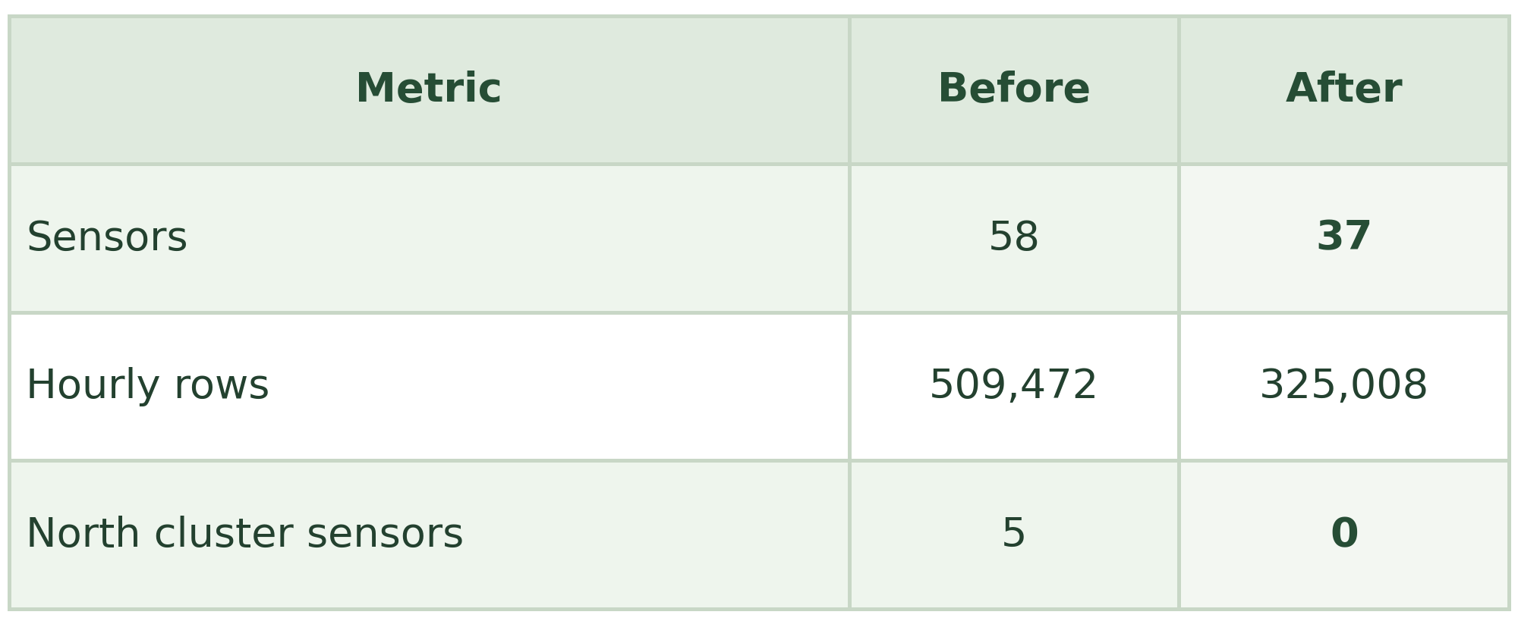
Data Processing
Addressing Missing Values

Slide 9
Case-Control Method
Case-control design and odds ratio calculation
Case Hours
Hours switch between light and dark throughout the year
  AM: 05:00–07:59
  PM: 17:00–19:59
Twilight excluded (solar alt. 0° to −6°)
2. Control Hours
Hours always light or always dark year-round
11:00 PM – 2:00 PM (Next Day)

Slide 10
Case-Control Method
Case-control design and odds ratio calculation
Odds Ratio Equation [8]
OR = (A / B) / (C / D)
A Count in case hour when light
B Count in case hour when dark
C Count in control hour when light
D Count in control hour when dark
Pooled Mantel-Haenszel OR [8][9]
Σ(A∙D / N)
MHᵂOR = ─────────
Σ(B∙C / N)
A, B, C, D Per-pair 2×2 table cells
N = A + B + C + D
Σ Over all valid hour pairs
[8] Fotios et al. (2024), odds-ratio sensitivity
[9] Mantel, N. and Haenszel, W. (1959) Journal of the National Cancer Institute, 22(4), 719-748.

Slide 11
Generalised Linear Model: Why?
Outcome = pedestrian counts (discrete and non negative)
Data is overdispersed (variance > mean)
Includes: time, weather[10][11] ,lags, darkness
Interpretable effects (percentage change)
Link: log(E[ped])
[10]Met Office. MIDAS Open: UK hourly weather observation data, v202507. NERC EDSCentre for Environmental Data Analysis, 2025.
[11] Met Office. MIDAS Open: UK hourly rainfall data, v202507. NERC EDS Centre forEnvironmental Data Analysis, 2025

Slide 12
GLM: Base Model Specification
Model Specification
log{E(y_{it})} = β₀ + β₁Dark_{it} + β₂Lag1 + β₃Lag24 + γ_{h} + δ_{d} + μ_{m} + θW_{t} + α_{i}
y_{it} Hourly pedestrian or cyclist count at sensor i in hour t
Lag1, Lag24 Count at same sensor 1 h and 24 h ago (captures short-run autocorrelation)
γ_{h} δ_{d} μ_{m} Hour-of-day, day-of-week, and month fixed effects
α_{i} Sensor fixed effect: absorbs all time-invariant location differences (footfall level, neighbourhood type, infrastructure)
θW_{t} Temperature, wind speed, rainfall in hour t
Dark_{it} Binary: 1 if sun is below horizon (civil twilight excluded), 0 if daylight
[12] Negative Binomial Regression: Second Edition, by Joseph M. Hilbe

Slide 13
GLM: Base Model Components
Time (hour, day, season) → patterns
Lag variables → capture short-term autocorrelation
Weather → affects activity
Darkness → main variable

Slide 14
GLM: Additional Model Specification
Model Specification
log{E(y_{it})} = β₀ + β₁Dark_{it} + β₂Lag1 + β₃Lag24 + γ_{h} + δ_{d} + μ_{m} + θW_{t} + α_{i}
Model 2
Dark × Cluster
Central · East · Outlier
Model 3
Dark × CCTV [13]
Model 4
Dark × Safety [14]
Model 5
Dark ×
(Streetlight [15] + Businesses[16] )
[13] Bristol City Council. Council cctv cameras. data.gov.uk dataset, 2024.
[14] 2025 Bristol City Council (2025), Quality of Life Survey 2024 to 2025: Final Report
[15]Bristol City Council. Streetlights and street furniture. data.gov.uk dataset, 2024.
[16] OpenStreetMap contributors. Openstreetmap. OpenStreetMap database, 2026

Slide 15
GLM: Comparison with Case-Control
Case-control: matches light VS dark periods
GLM: Controls time, weather, autocorrelation...
Both depict darkness reduces walking

Slide 16
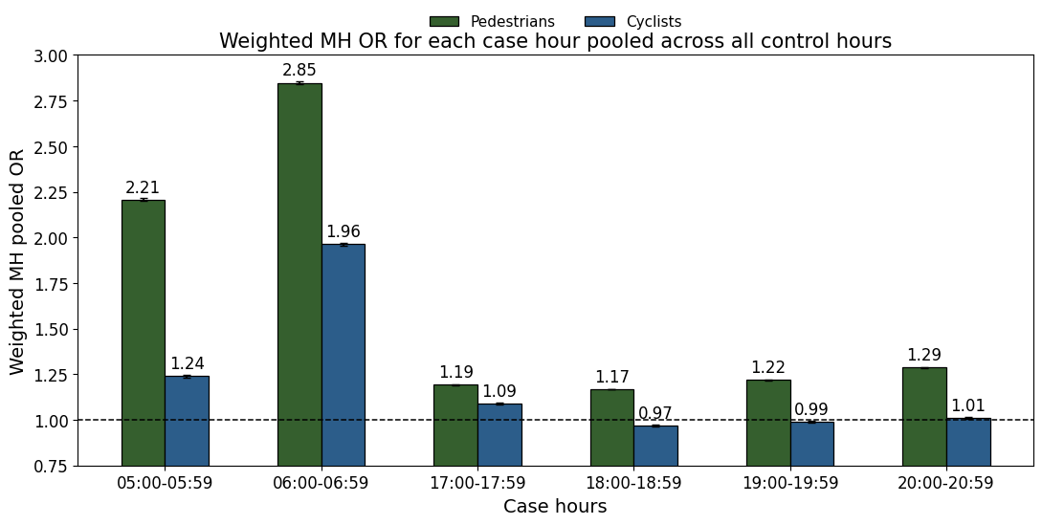
Case-Control
Results
Odds ratio sensitivity was tested across varying case/control hour combinations
Largest reduction during morning hours (5am – 7am)
Darkness suppresses pedestrian counts more than other sensor types

Slide 17
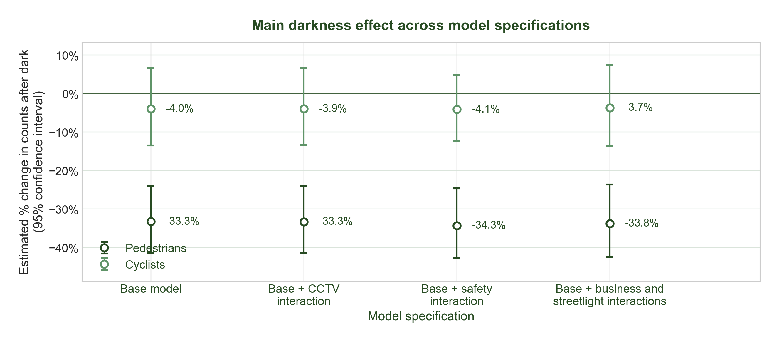
GLM Results
Key Findings
97% of sensors show lower pedestrian counts in darkness
GLM result stable across all model specifications
P-value for cyclist: 0.313
P-value for pedestrians: 1.48e-10

Slide 18
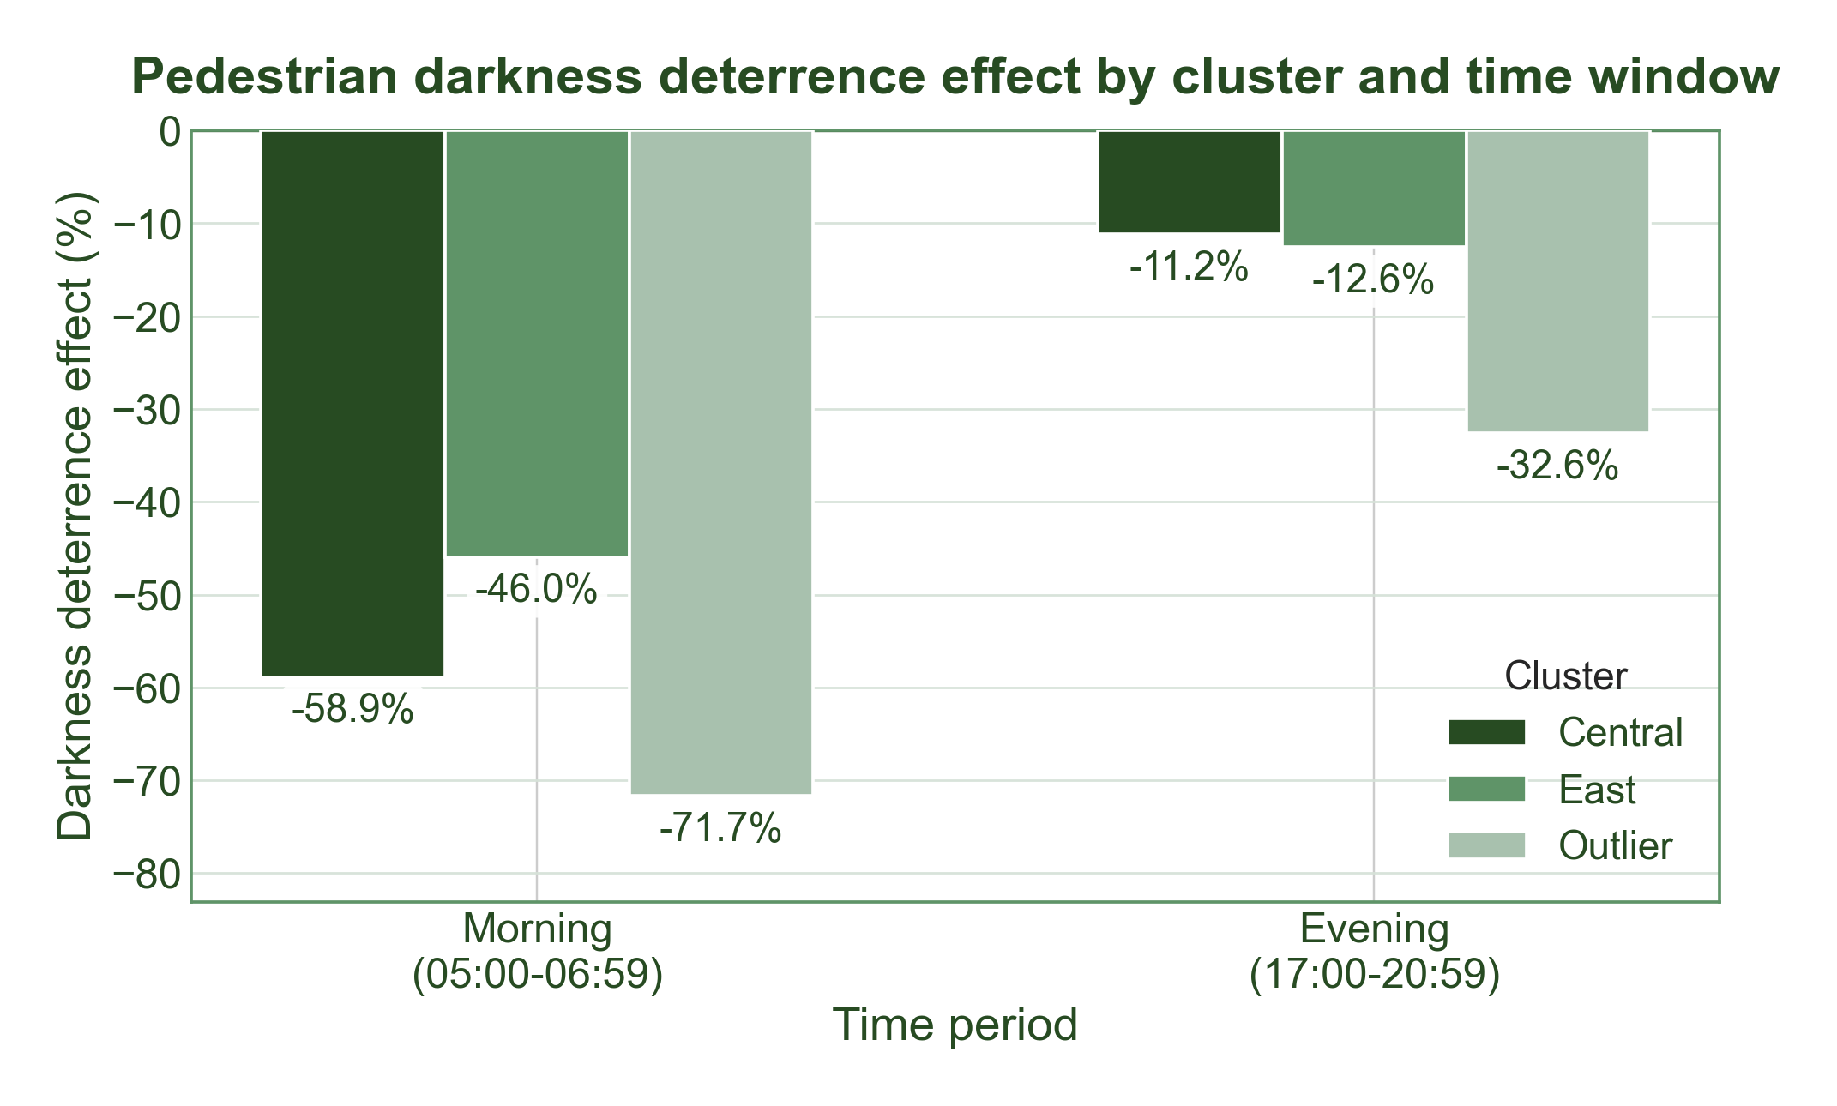
Early morning hours need priority action
What the time discrepancies show
Morning penalty (−59%) is more than double the evening penalty (−19%)
Other factors could be the root cause of these differences

Slide 19
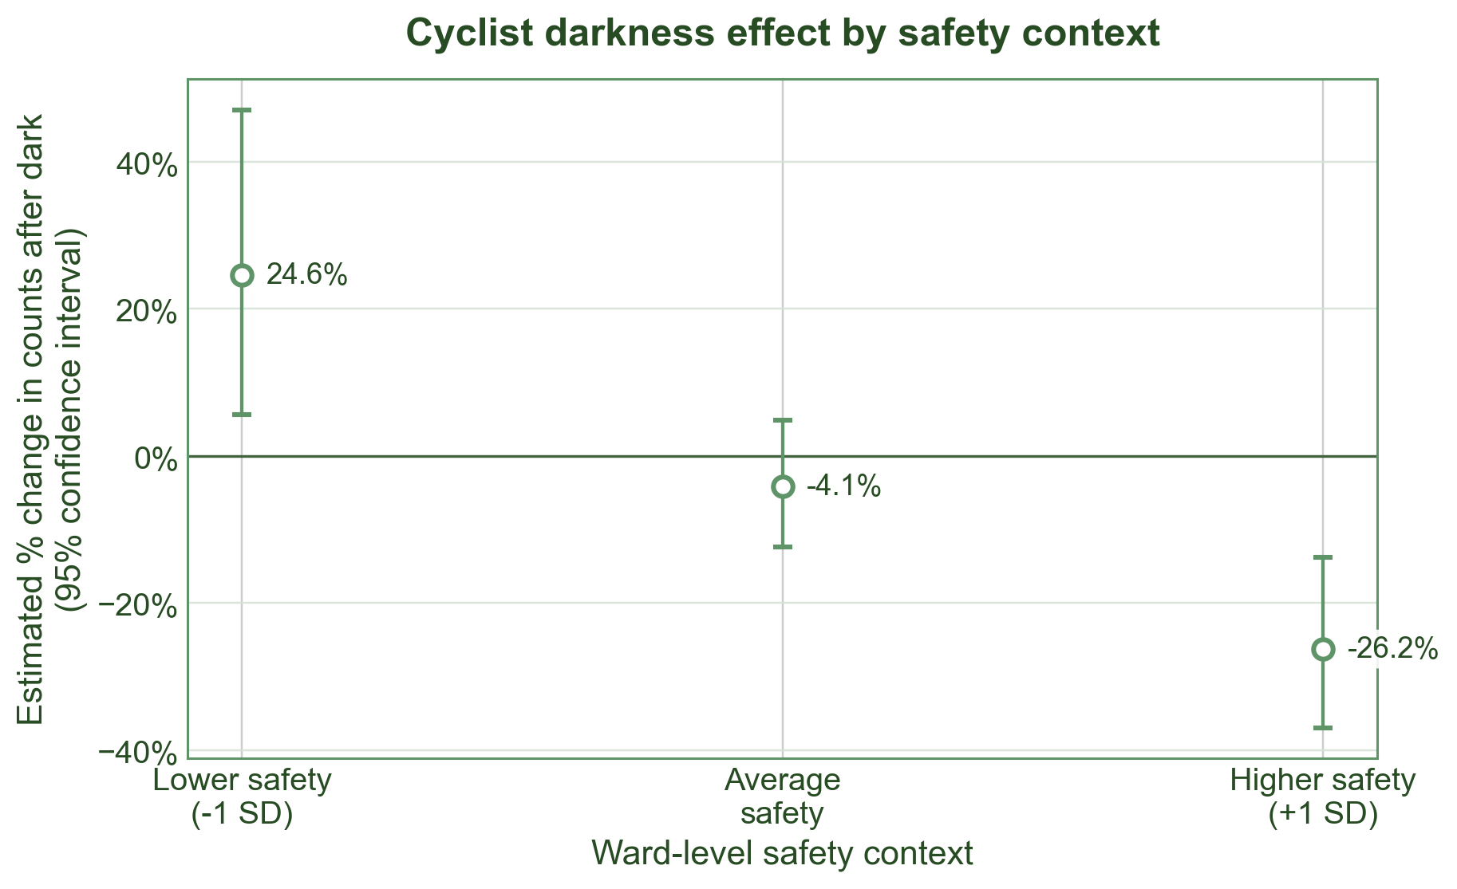
Other factors to consider
Moderation Results
Moderator | Pedestrians | Cyclists
Dark × CCTV | p = 0.948 | p = 0.941
Dark × Safety | p = 0.160 | p = 0.000121
Key insights:
CCTV has little impact on darkness effect, perhaps down to the location of CCTV being unknown to most people
Perceived safety by people does have an effect on darkness with a higher ward safety score leading to a larger reduced change in darkness.

Slide 20
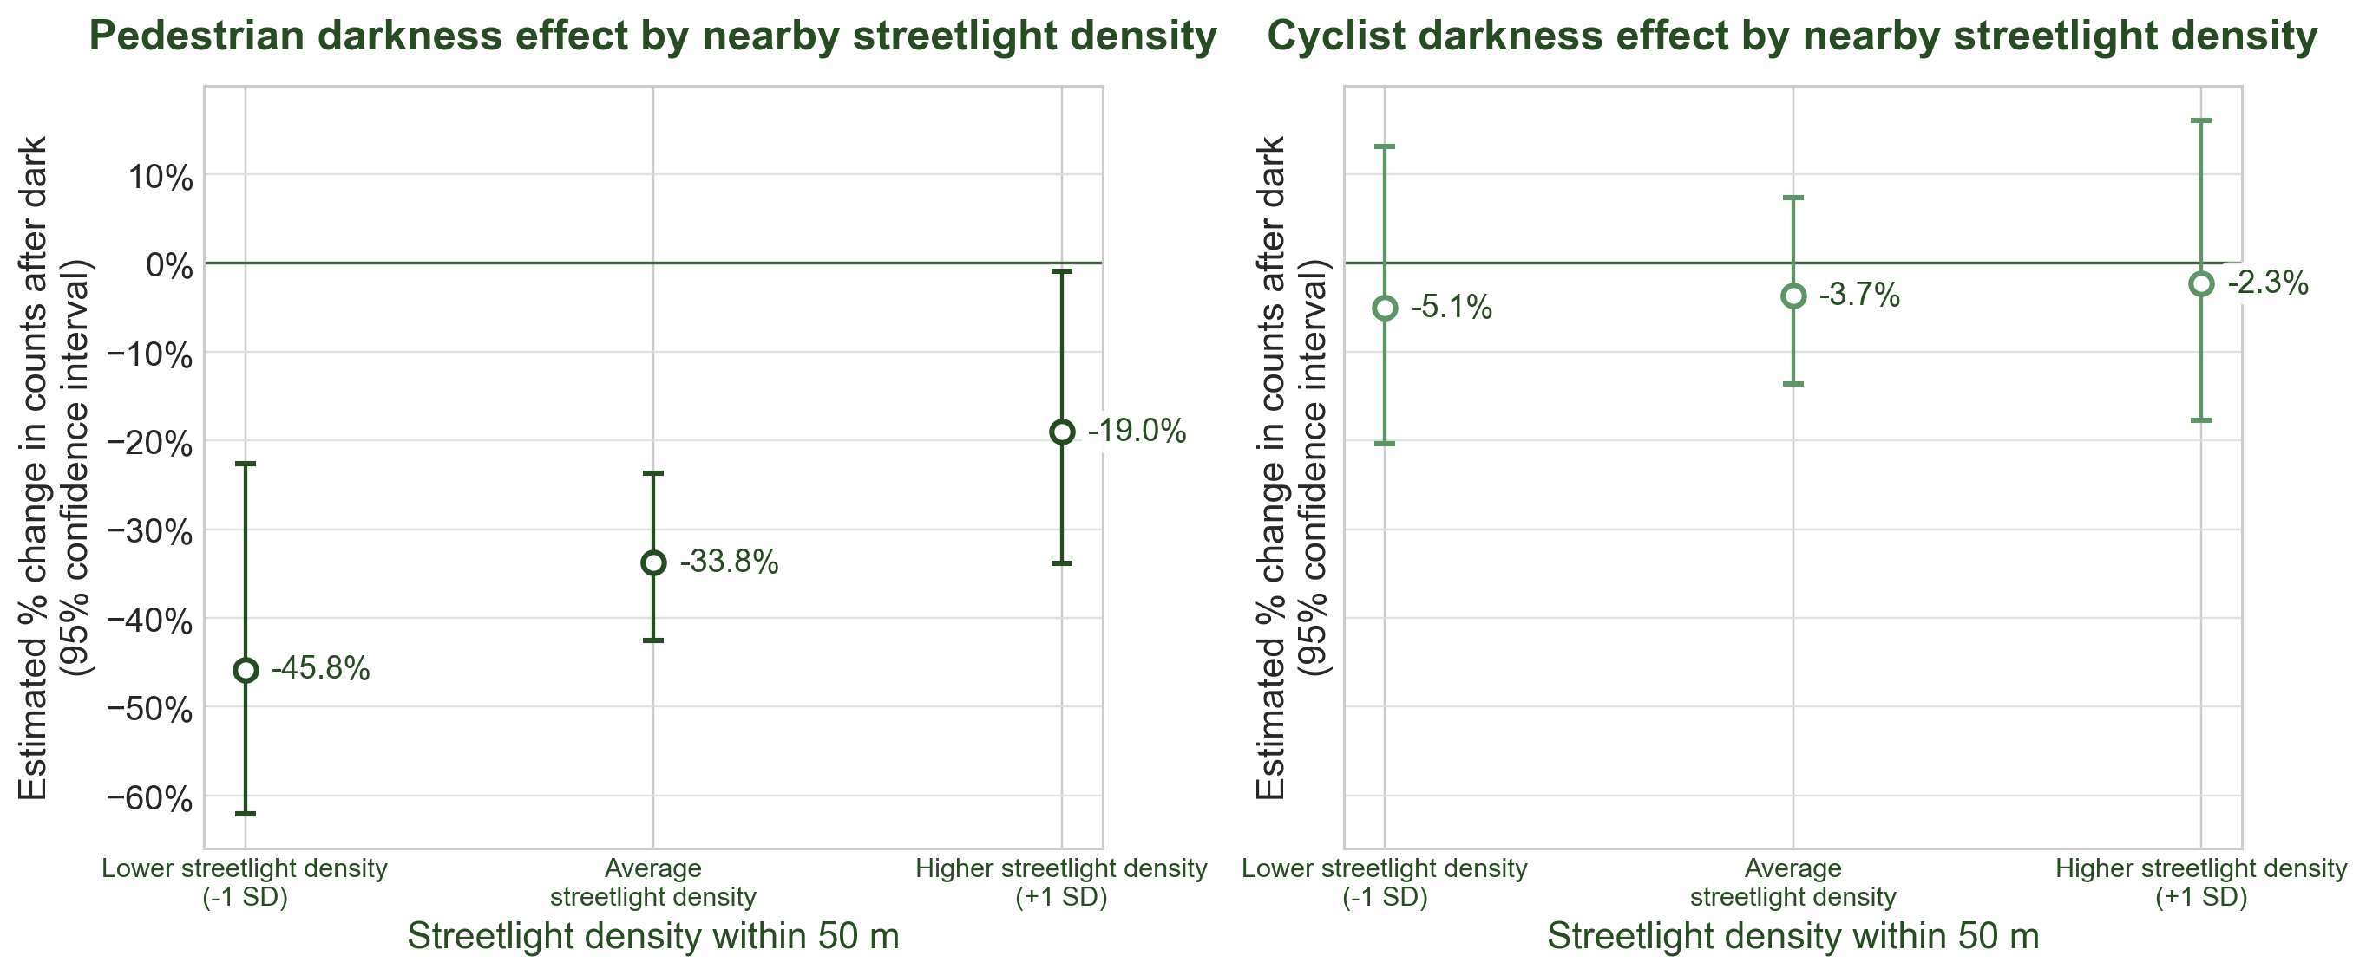
Streetlights
Streetlights cause the largest decrease in the effect of darkness for pedestrians out of all safety factors
Little to no change for cyclists, likely due to their own lights improving visibility

Slide 21
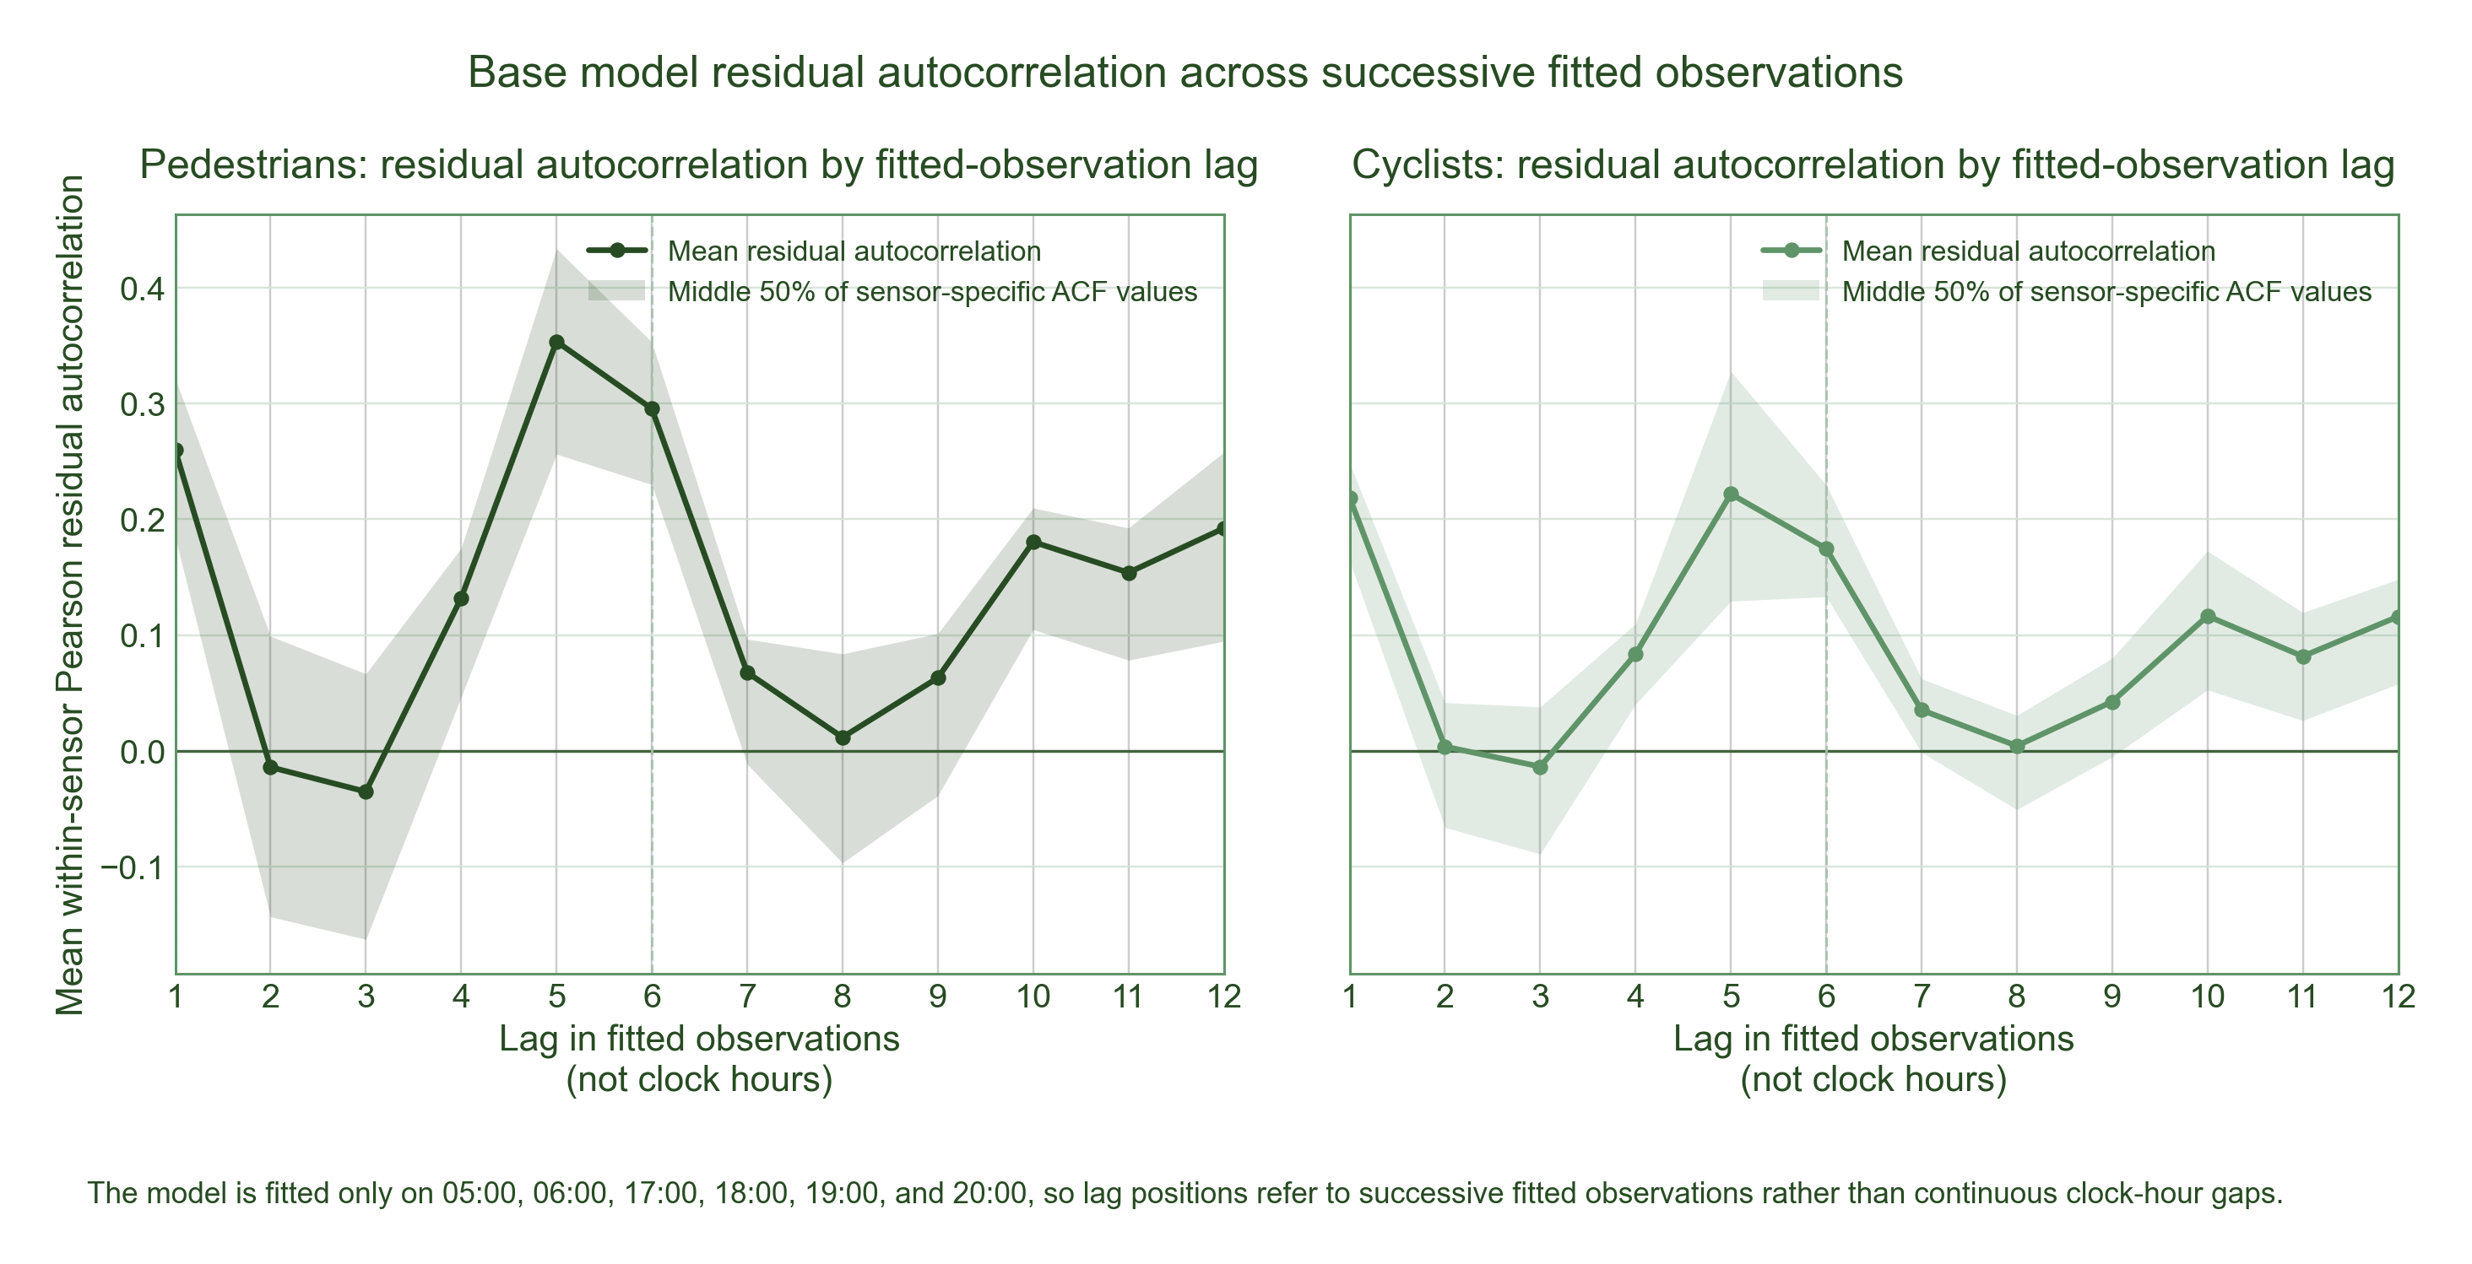
Limitations of the GLM
Residual autocorrelation, even with the time controls
Only used case hours, instead of whole time series
Certain interactions, like darkness with CCTV, are statistically weak

Slide 22
Targeted Timing: The Morning Commute
MORNING
EVENING
Central has the largest loss
Streetlight density is the key factor
203 count increase for pedestrians over 5 hours

Slide 23
LED Streetlight Investment Plan
REVENUE PATH
+203 peds/day
from +1 SD streetlight increase
× 130 winter days
= 26,390 additional visits
½ buy a coffee
13,195 purchases @ £4 avg
£52,780 / year
boost to local economy
3.4 Year ROI
£180,250 ÷ £52,780/yr
COST PATH
515 streetlamps
in Bristol central cluster [15]
× £350 each
avg LED upgrade cost [9]
£180,250 total
capital investment required
Bristol City Council. Streetlights and street furniture. data.gov.uk dataset, 2024.[15] | LED upgrade cost: Bristol City Council (publicsectorexecutive.com) [17]

